Slide 1

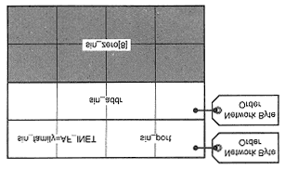
Internet (IPv4) Socket Addresses
The most commonly used address family under Linux is the AF_INET family.
This gives a socket an IPv4 socket address to allow it to communicate with other hosts over a TCP/IP network.
structure sockaddr_in is used to give address for these sockets
struct sockaddr_in {
sa_family_t sin_family; /* Address Family */
uint16_t sin_port; /* Port number */
struct in_addr sin_addr;/* Internet address */
unsigned char sin_zero[8]; /* Pad bytes */
};
struct in_addr { uint32_ t s_ addr; /* Internet address */ };

Slide 2
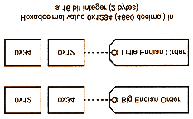
Understanding Network Byte Order
Different CPU architectures have different arrangements for grouping multiple bytes of data together to form integers of 16, 32, or more bits. The two most basic byte orderings are
  Big-endian
    places the most significant byte first
  Little-endian
    places the least significant byte first
Intel CPU uses the little-endian byte order.
Other CPUs like the Motorola 68000 series use the big-endian byte order.
What happens if a Motorola CPU were to write a 16-bit number to the network and is received by an Intel CPU?
  bytes will be interpreted in the reverse order for the Intel CPU, causing it to see the value as 0x3412 rather than 0x1234

Slide 3
Network byte order : big-endian
For agreement to exist over the network, it was decided that big-endian byte order would be the order used on a network.
TCP/IP port number (sin_port) and the IP address (sin_addr) must be in network byte order

Slide 4
Performing Endian Conversions
We have 2 directions of conversions
  Host ordering to network ordering
  Network ordering to host ordering
Also have 2 categories of conversions
  Short (16-bit) integer conversion
  Long (32-bit) integer conversion

Slide 5
Functions for endian Conversions
  #include <netinet/in.h>
  unsigned long htonl(unsigned long hostlong);
  unsigned short htons(unsigned short hostshort);
  unsigned long ntohl(unsigned long netlong);
  unsigned short ntohs(unsigned short netshort);
"short" refers to a 16-bit value and "long" refers to a 32-bit value
“h” in the function name refers to "host," “n” refers to "network"
Similarly, “s” refers to "short" and “l” refers to "long"
Example:
short host_ short = 0x1234; //short value in little endian(host order)
short netw_short; // short value in big endian(network order)
netw_short = htons(host_short); // converts a short value from host to network order
host_short = ntohs(netw_short); // converts a short value from network to host order

